Slide 1

Team Shiba: Menu Ordering System
By: Aaryan (19501), Ahmed (19504), Dhruv (19520)

Slide 2
Initial plan
We planned to create a system where a restaurant can have a site where people can pick their orders from an electrical device instead of using a physical menu
During covid we realized that a lot of things can be replaced including restaurant menus
A lot of restaurants forced us to use QR codes from our phone in order to use their menu

Slide 3
What we used
Front end: We used ReactJS. We found it the easiest to implement with the backend and database
Database: Mongo dB was used due to its ease of use
Backend: We decided to go with Nodejs as it sat well with the frontend part

Slide 4
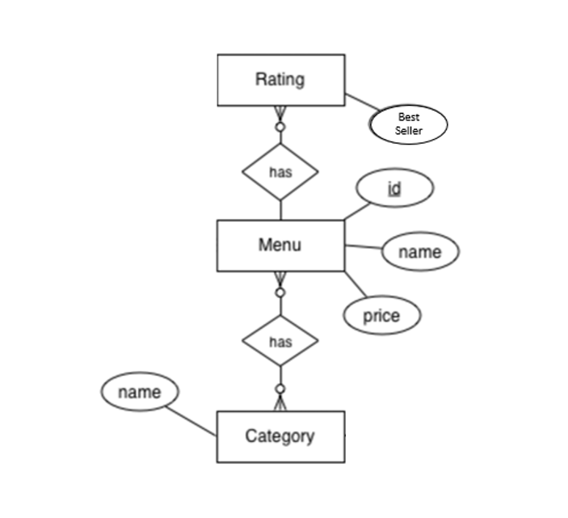
ER Diagram

Slide 5
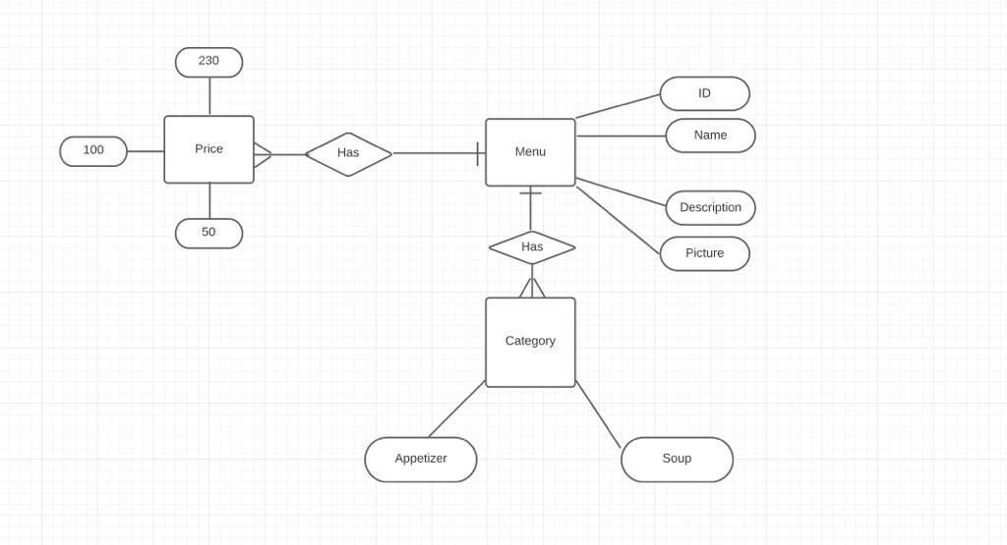

Slide 6

Project demo

